Slide 1
Lecture 3 Condensation in deep learning
Zhi-Qin John Xu 许志钦
Shanghai Jiao Tong University
Sunday, January 12, 2025

Slide 2
How hyperparameters affect training?
Phase diagram

Slide 3
How initialization hyperparameters affect training?
Phase diagram

Slide 4
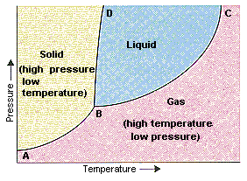
Phase diagram
Phase diagram for matter
distinctive states of matter <-> environment
(phase transition happens at infinite size limit)
solid, liquid, gas <-> pressure, temperature
Phase diagram for two-layer ReLU NN
distinctive training dynamics <-> initialization
($m→∞$)
? <->?
Can we find quantities that determines NN behavior?
Tao Luo#, Zhi-Qin John Xu #, Zheng Ma, Yaoyu Zhang*,
Phase diagram for two-layer ReLU neural networks at infinite-width limit, Journal of Machine Learning Research (2021)

Slide 5
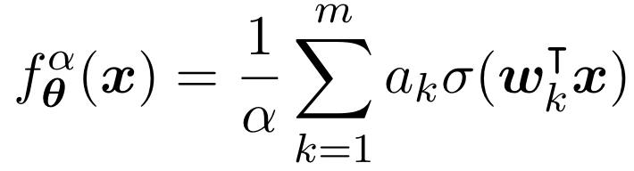
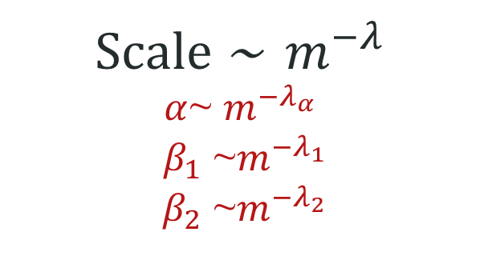
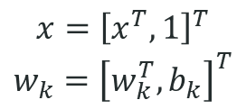
Initialization methods with their scaling parameters
Two-layer NN
$$x={\left[x^{T},1\right]}^{T}$$
$$w_{k}={\left[w_{k}^{T},b_{k}\right]}^{T}$$
Common initialization
Scale ~ $m^{−λ}$
$α$~ $m^{−λ_{α}}$
$β_{1}$ ~$m^{−λ_{1}}$
$β_{2}$ ~$m^{−λ_{2}}$
Gaussian/Uniform distribution
Tao Luo#, Zhi-Qin John Xu #, Zheng Ma, Yaoyu Zhang*,
Phase diagram for two-layer ReLU neural networks at infinite-width limit, Journal of Machine Learning Research (2021)

Slide 6
Motivation：different results by different initializations
large ini
medium ini
Small ini
Tao Luo#, Zhi-Qin John Xu #, Zheng Ma, Yaoyu Zhang*,
Phase diagram for two-layer ReLU neural networks at infinite-width limit, Journal of Machine Learning Research (2021)

Slide 7
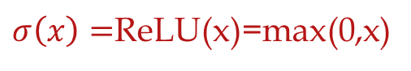
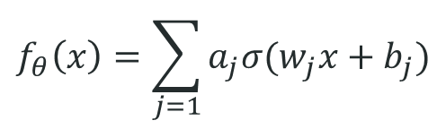
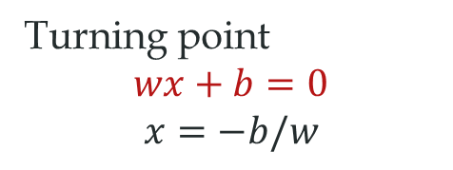

Motivation：different results by input weights
$σ\left(x\right)=$ReLU(x)=max(0,x)
Act func: $σ\left(wx+b\right)$
$$f_{θ}\left(x\right)=\sum_{j=1}{a_{j}σ(w_{j}x+b_{j})}$$
Turning point
$$wx+b=0$$
$$x=−b/w$$
large ini
medium ini
Small ini
Many turnings
Many turnings
But learned!
Two turnings
Tao Luo#, Zhi-Qin John Xu #, Zheng Ma, Yaoyu Zhang*,
Phase diagram for two-layer ReLU neural networks at infinite-width limit, Journal of Machine Learning Research (2021)

Slide 8
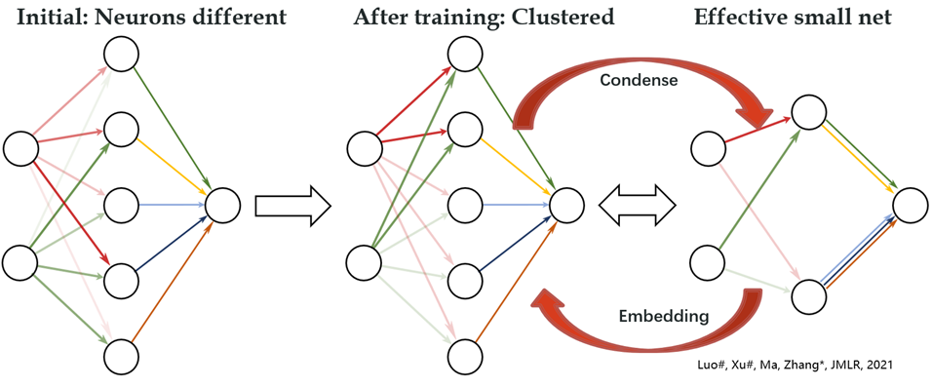

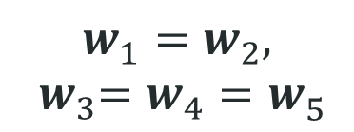
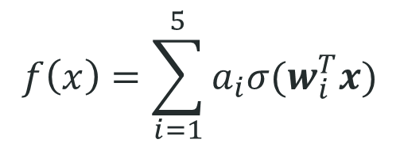
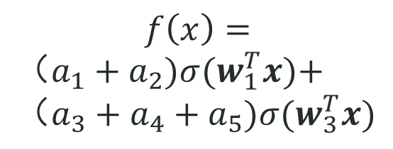
Condensation with small initialization
$$f\left(x\right)=\sum_{i=1}^{5}{a_{i}σ(w_{i}^{T}x)}$$
$$f\left(x\right)=$$
$（a_{1}+a_{2})σ(w_{1}^{T}x)\text{+}$ $（a_{3}+a_{4}+a_{5})σ(w_{3}^{T}x)$
$$w_{1}^{ }=w_{2}^{ },$$
$${ w}_{3}^{ }=w_{4}^{ }=w_{5}^{ }$$
Initial：random
After training：
Condense
Effective：
Small net

Slide 9

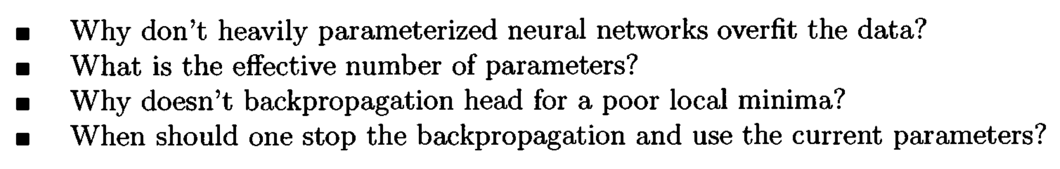
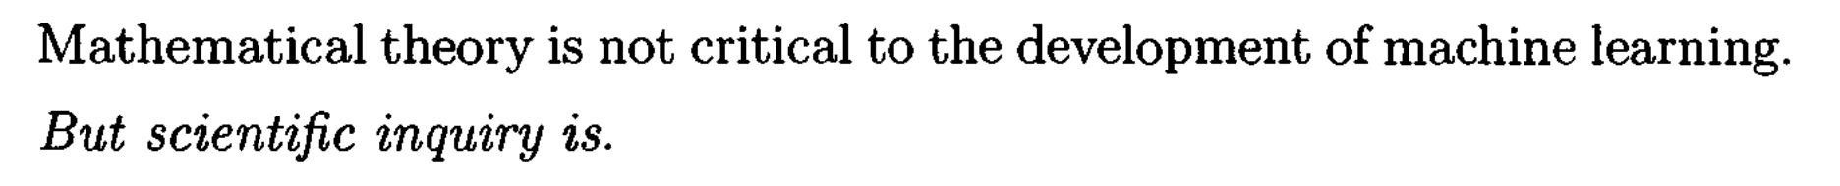
Long-standing problems
1995

Slide 10
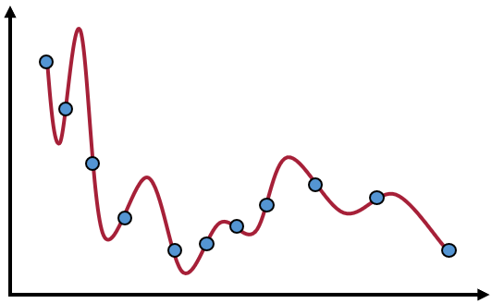
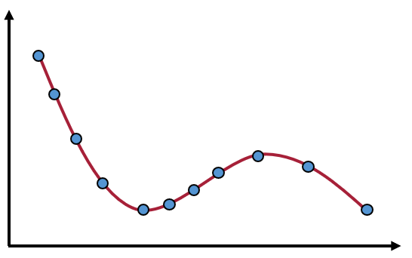
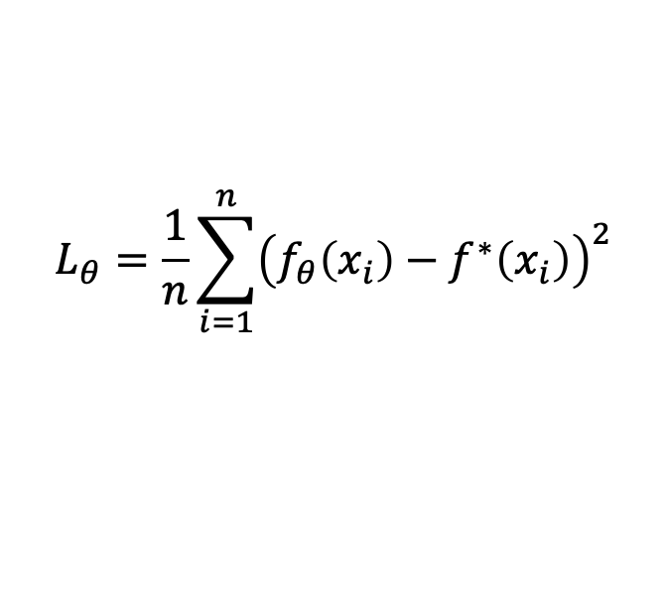
Implicit bias (regularization)
Loss=0：
……
Train
#para> #sample
Mul. Sol.
Sol. With good gen.
$$L_{θ}=\frac{1}{n}\sum_{i=1}^{n}{{\left(f_{θ}\left(x_{i}\right)−f^{∗}\left(x_{i}\right)\right)}^{2}}$$
But, no difference in loss function：
A key Question：
What is implicit bias of neural networks during training?

Slide 11
Implicitly bias toward simple function
Advantage of frequency principle and condensation：
Rigorous theoretical analysis
Inspire more efficient algorithms
Simple but explain overparameterization puzzle
Traditional methods
(#para>#sample)
Neural networks
can
Bias towards
overfit
Simple
High-freq！
Large-complexity！
Low-freq！
Small effective neuron #！

Slide 12
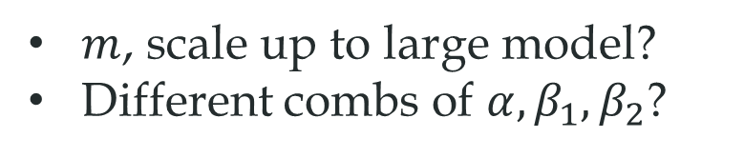
What quantities to differentiate regimes
$m$, scale up to large model?
Different combs of $α, β_{1}, β_{2}$?

Slide 13
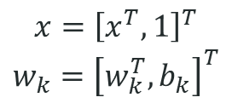
The key factors for regimes
non-linear activation function
$$x={\left[x^{T},1\right]}^{T}$$
$$w_{k}={\left[w_{k}^{T},b_{k}\right]}^{T}$$
Only $w_{k}$ affects the non-linearity
Tao Luo#, Zhi-Qin John Xu #, Zheng Ma, Yaoyu Zhang*,
Phase diagram for two-layer ReLU neural networks at infinite-width limit, Journal of Machine Learning Research (2021)

Slide 14

The key factors for regimes
non-linear activation function
$$x={\left[x^{T},1\right]}^{T}$$
$$w_{k}={\left[w_{k}^{T},b_{k}\right]}^{T}$$
Only $w_{k}$ affects the non-linearity
Tao Luo#, Zhi-Qin John Xu #, Zheng Ma, Yaoyu Zhang*,
Phase diagram for two-layer ReLU neural networks at infinite-width limit, Journal of Machine Learning Research (2021)

Slide 15
Motivation：different results by input weights
$σ\left(x\right)=$ReLU(x)=max(0,x)
Act func: $σ\left(wx+b\right)$
$$f_{θ}\left(x\right)=\sum_{j=1}{a_{j}σ(w_{j}x+b_{j})}$$
Turning point
$$wx+b=0$$
$$x=−b/w$$
large ini
medium ini
Small ini
Many turnings
Many turnings
But learned!
Two turnings
Tao Luo#, Zhi-Qin John Xu #, Zheng Ma, Yaoyu Zhang*,
Phase diagram for two-layer ReLU neural networks at infinite-width limit, Journal of Machine Learning Research (2021)

Slide 16
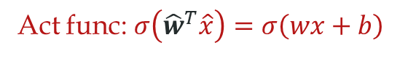

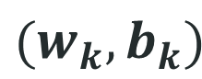

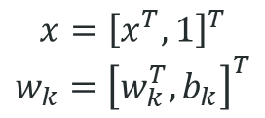




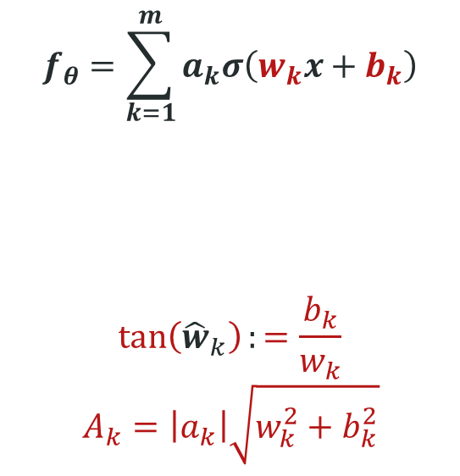
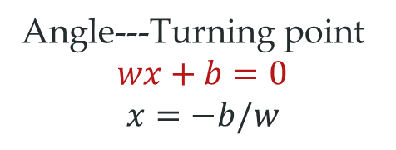
2-layer ReLU neural network
$σ\left(x\right)=$ReLU(x)=max(0,x)
$$f_{θ}=\sum_{k=1}^{m}{a_{k}σ\left(w_{k}x+b_{k}\right)}$$
$$\tan\left({\hat{w}}_{k}\right):=\frac{b_{k}}{w_{k}}$$
$$A_{k}=\left|a_{k}\right|\sqrt{w_{k}^{2}+b_{k}^{2}}$$
For 1d input, $(w_{k},b_{k})$ is a 2d vector.
We use ${\hat{w}}_{k}$to denote its orientation
$$x={\left[x^{T},1\right]}^{T}$$
$$w_{k}={\left[w_{k}^{T},b_{k}\right]}^{T}$$
$$b_{k}$$
$$(w_{k},b_{k})$$
Act func: $σ\left({\hat{w}}^{T}\hat{x}\right)=σ\left(wx+b\right)$
Angle---Turning point
$$wx+b=0$$
$$x=−b/w$$
$${\hat{w}}_{k}∈(−π,π]$$
$$w_{k}$$
Angle：$\tan\left(\hat{w}\right)=b/w$
Tao Luo#, Zhi-Qin John Xu #, Zheng Ma, Yaoyu Zhang*,
Phase diagram for two-layer ReLU neural networks at infinite-width limit, Journal of Machine Learning Research (2021)

Slide 17
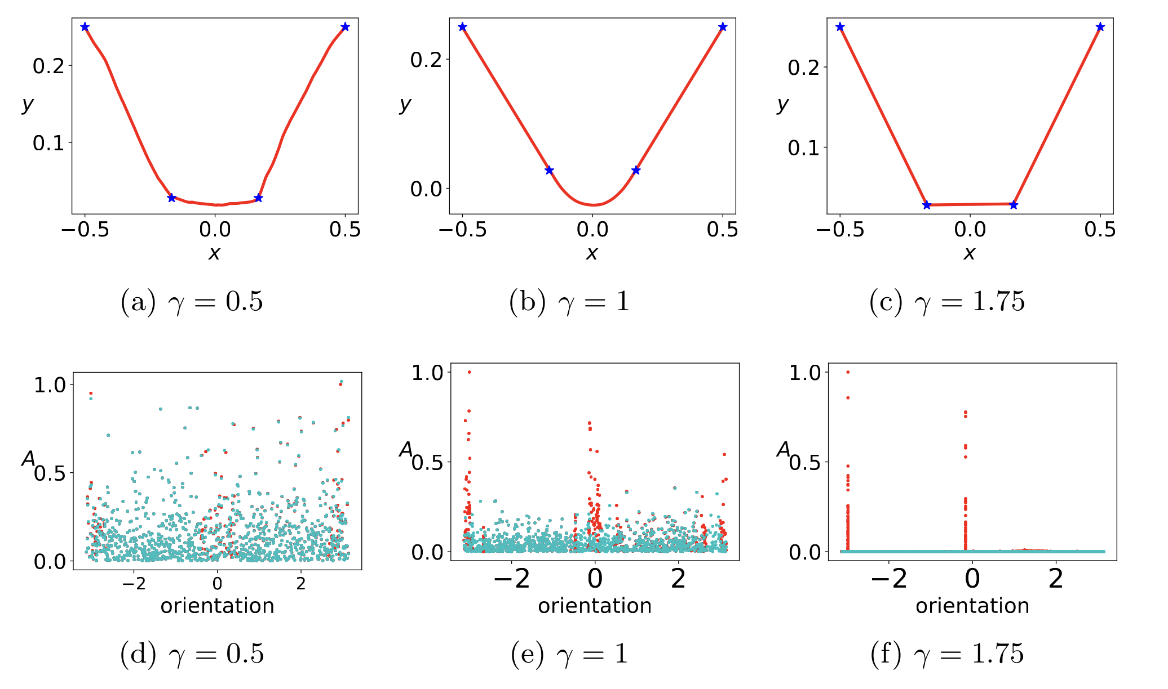
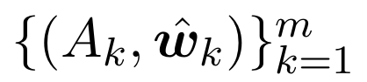
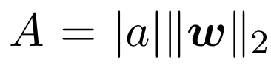
Typical cases across the phase diagram
Linear regime
critical regime
condensed regime
$$γ^{′}=0$$
Tao Luo#, Zhi-Qin John Xu #, Zheng Ma, Yaoyu Zhang*,
Phase diagram for two-layer ReLU neural networks at infinite-width limit, Journal of Machine Learning Research (2021)

Slide 18
Small ini: tend to condensation
Large ini: tend to linear

Slide 19
How small or how large?

Slide 20
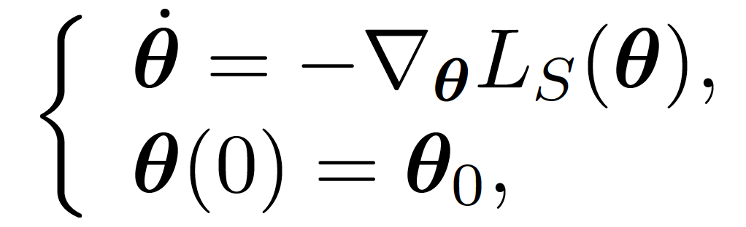
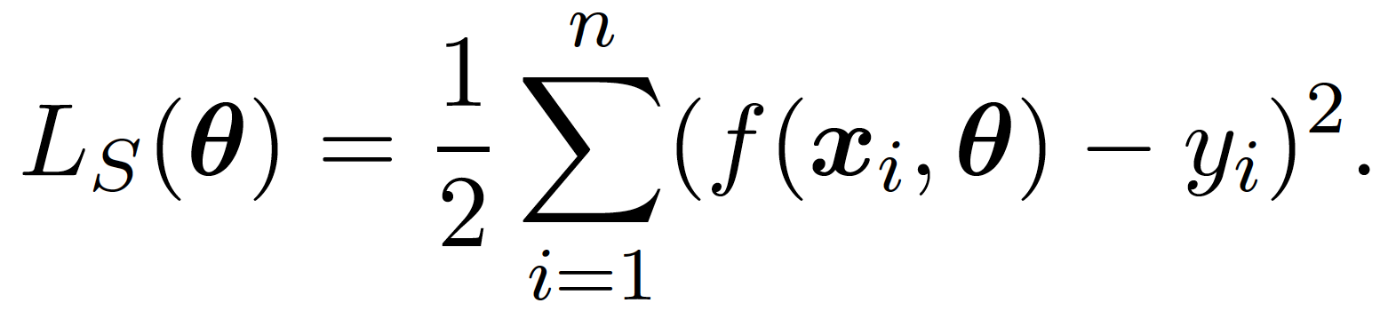
Tao Luo#, Zhi-Qin John Xu #, Zheng Ma, Yaoyu Zhang*,
Phase diagram for two-layer ReLU neural networks at infinite-width limit, Journal of Machine Learning Research (2021)

Slide 21
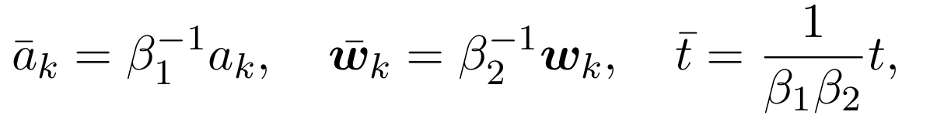
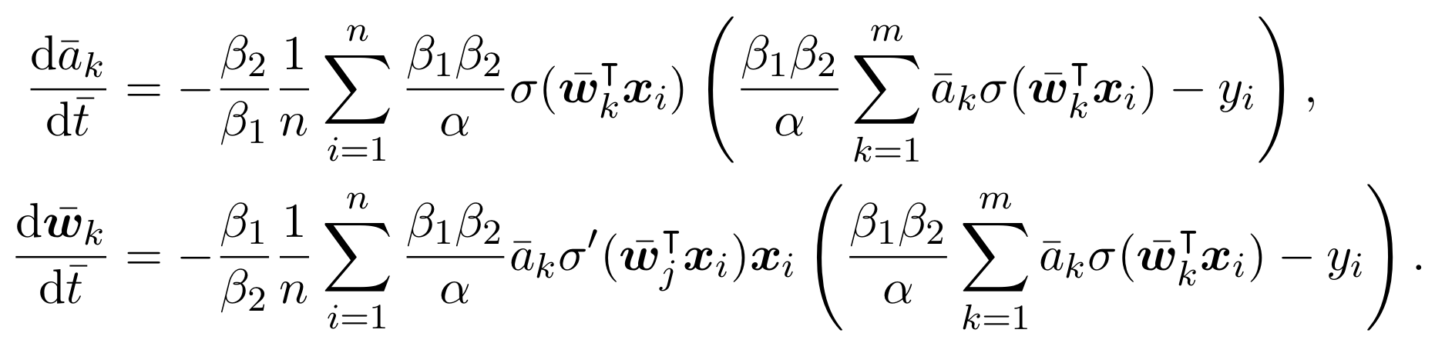
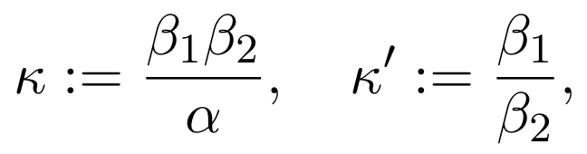
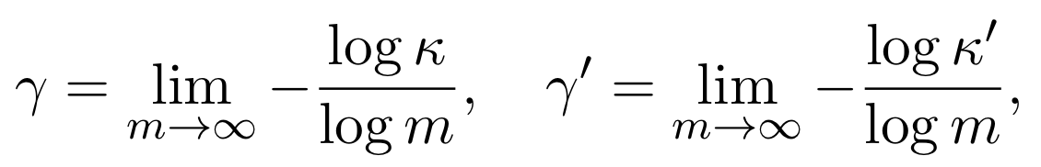
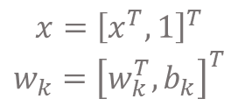
Setup
Two layer ReLU network at infinite-width limit
Normalized gradient flow
Scaling parameters and infinite-width limit
$$x={\left[x^{T},1\right]}^{T}$$
$$w_{k}={\left[w_{k}^{T},b_{k}\right]}^{T}$$
Tao Luo#, Zhi-Qin John Xu #, Zheng Ma, Yaoyu Zhang*,
Phase diagram for two-layer ReLU neural networks at infinite-width limit, Journal of Machine Learning Research (2021)

Slide 22
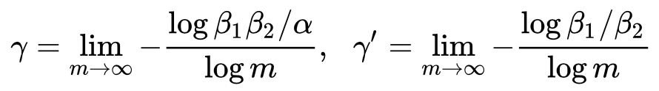
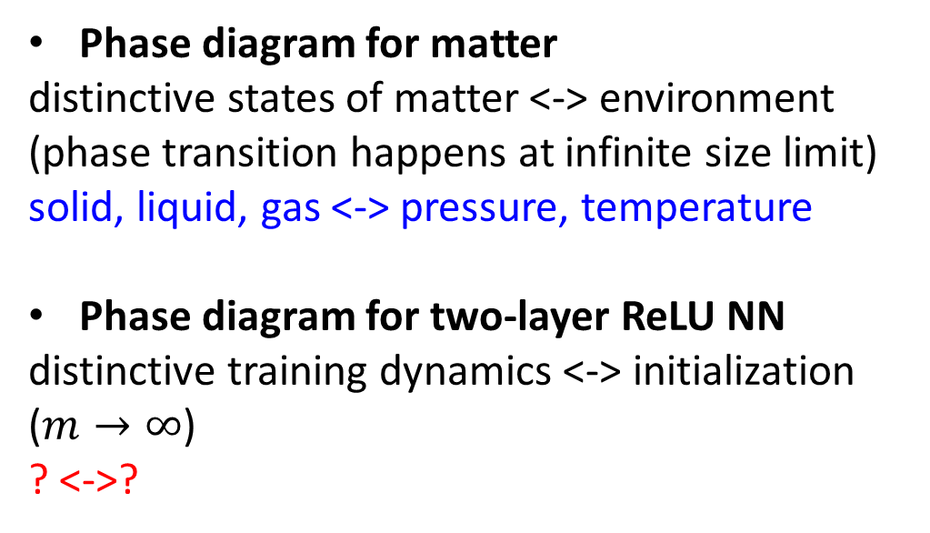
Phase diagram
Phase diagram for matter
distinctive states of matter <-> environment
(phase transition happens at infinite size limit)
solid, liquid, gas <-> pressure, temperature
Phase diagram for two-layer ReLU NN
distinctive training dynamics <-> initialization
($m→∞$)
? <->?
Identification of coordinates of phase diagram (in analogy to pressure, temperature)
Effectively independent
Dynamical similarity
Differentiation capability
Tao Luo#, Zhi-Qin John Xu #, Zheng Ma, Yaoyu Zhang*,
Phase diagram for two-layer ReLU neural networks at infinite-width limit, Journal of Machine Learning Research (2021)

Slide 23
Initialization methods with their scaling parameters
Tao Luo#, Zhi-Qin John Xu #, Zheng Ma, Yaoyu Zhang*,
Phase diagram for two-layer ReLU neural networks at infinite-width limit, Journal of Machine Learning Research (2021)

Slide 24
Linear/nonlinear regimes

Slide 25
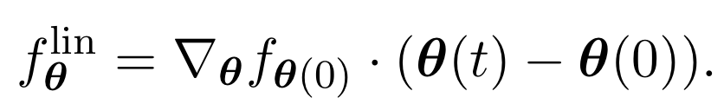
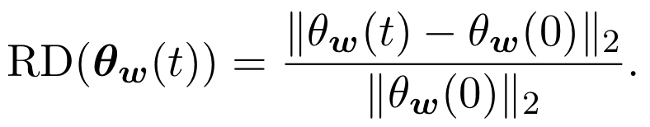
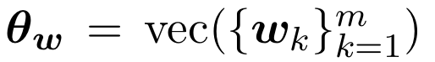
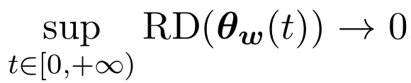
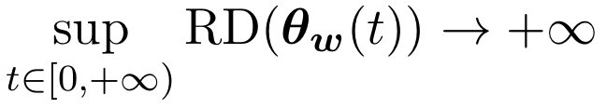
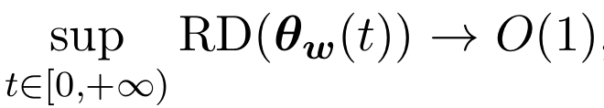
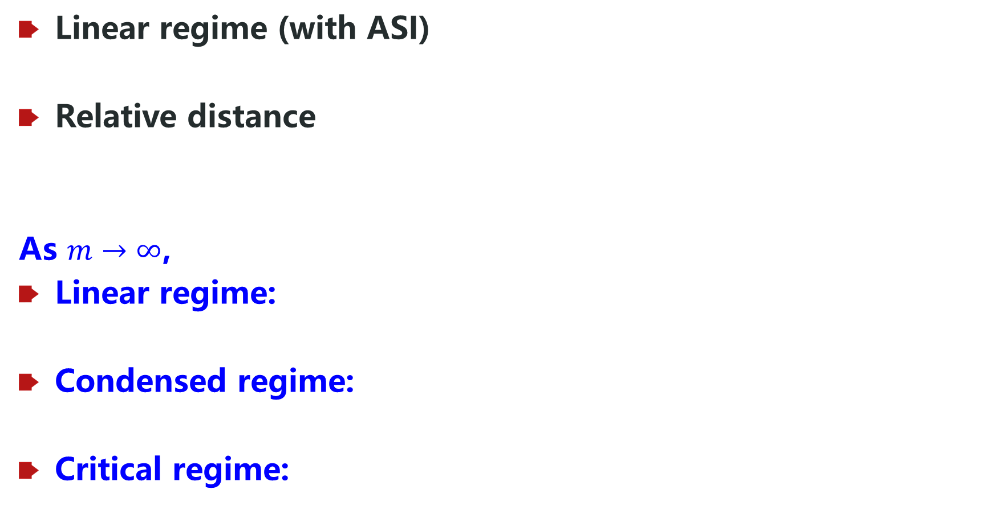
Regime identification
Linear regime (with ASI)
Relative distance
As $m→∞$,
Linear regime:
Condensed regime:
Critical regime:
Tao Luo#, Zhi-Qin John Xu #, Zheng Ma, Yaoyu Zhang*,
Phase diagram for two-layer ReLU neural networks at infinite-width limit, Journal of Machine Learning Research (2021)

Slide 26
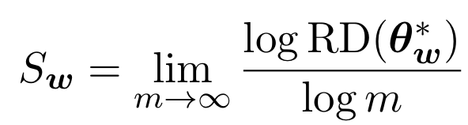
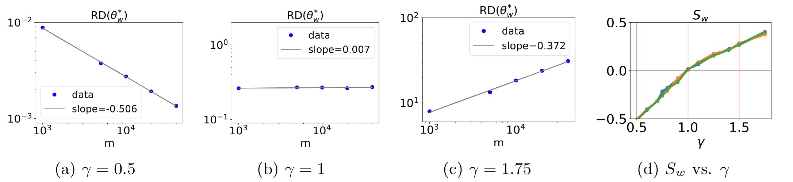
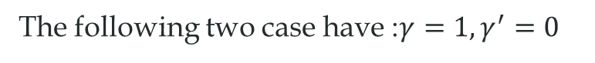
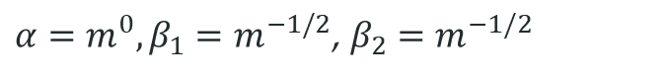
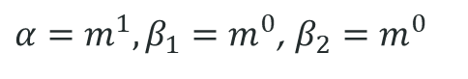
Regime identification through experiments
$$γ^{′}=0$$
The following two case have :$γ=1,γ^{′}=0$
$α=m^{1},β_{1}=m^{0}$, $β_{2}=m^{0}$
$α=m^{0},β_{1}=m^{−1/2}$, $β_{2}=m^{−1/2}$
Tao Luo#, Zhi-Qin John Xu #, Zheng Ma, Yaoyu Zhang*,
Phase diagram for two-layer ReLU neural networks at infinite-width limit, Journal of Machine Learning Research (2021)

Slide 27
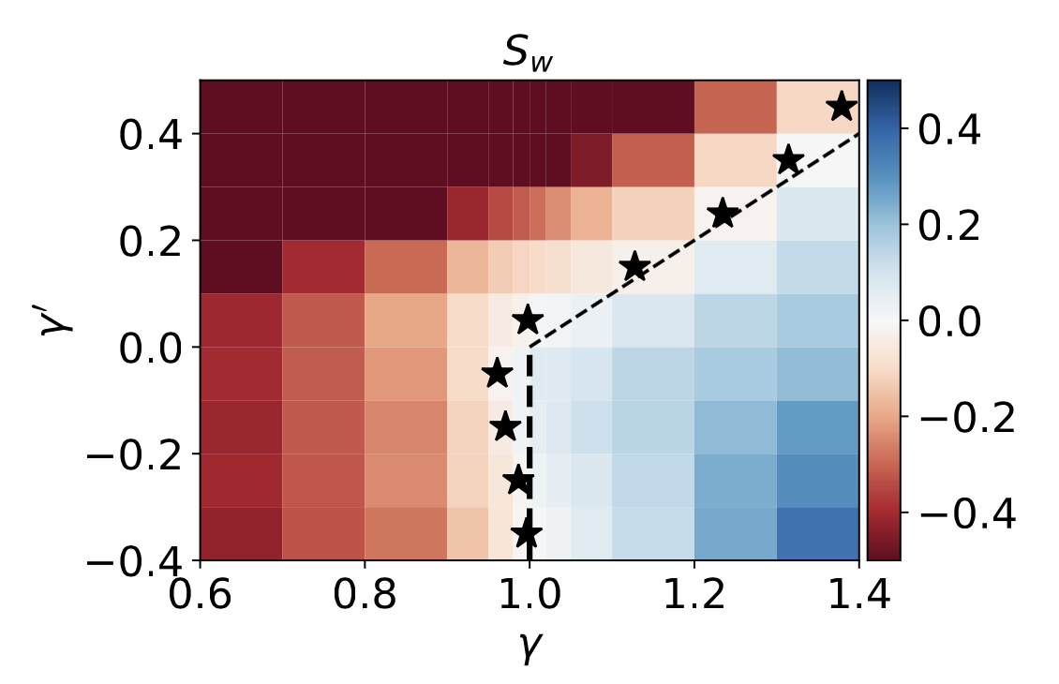
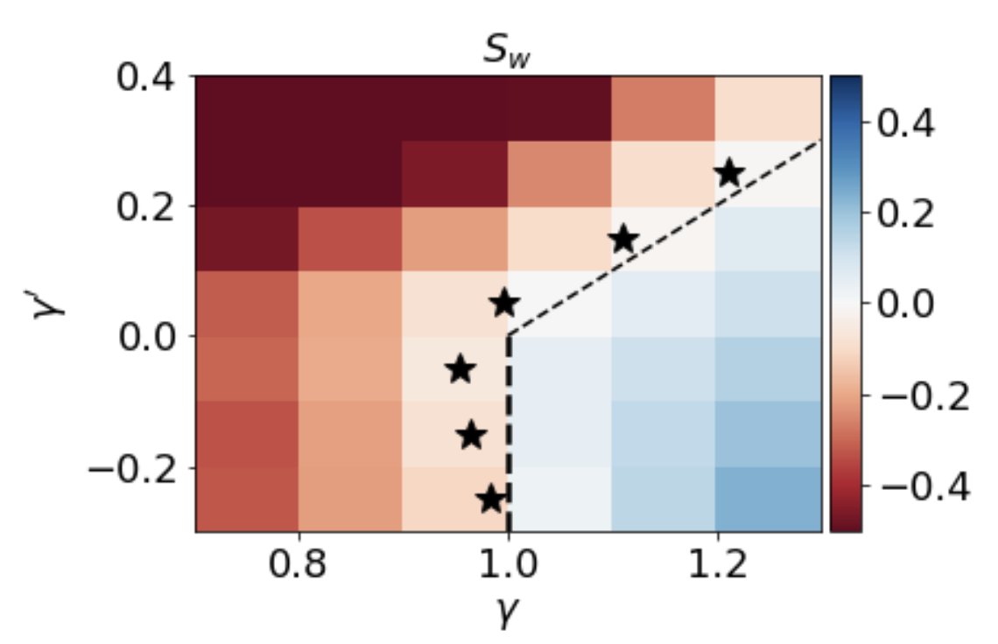
Regime identification through experiments
Synthetic data
MNIST data
Tao Luo#, Zhi-Qin John Xu #, Zheng Ma, Yaoyu Zhang*,
Phase diagram for two-layer ReLU neural networks at infinite-width limit, Journal of Machine Learning Research (2021)

Slide 28
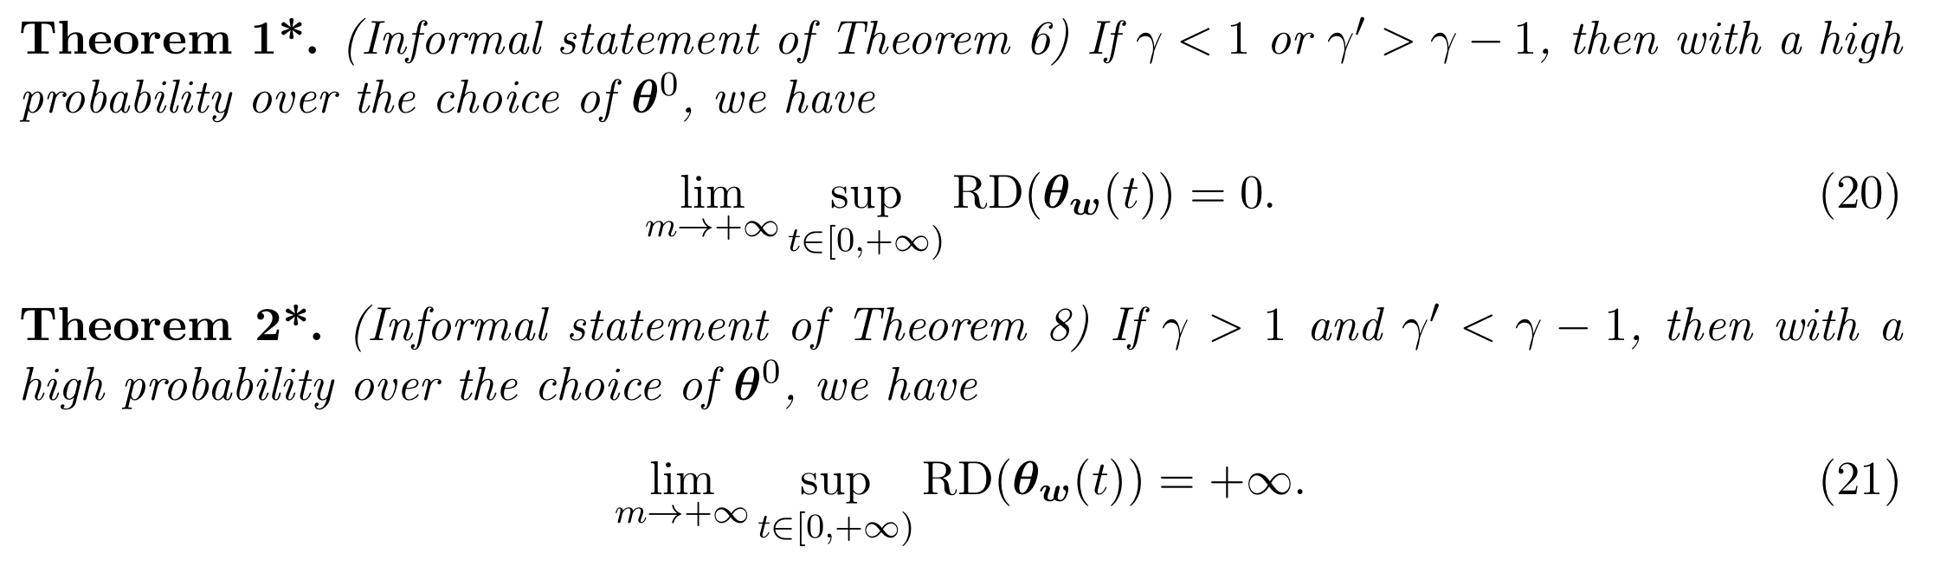
Regime identification through experiments
Tao Luo#, Zhi-Qin John Xu #, Zheng Ma, Yaoyu Zhang*,
Phase diagram for two-layer ReLU neural networks at infinite-width limit, Journal of Machine Learning Research (2021)
Tao Luo#, Zhi-Qin John Xu #, Zheng Ma, Yaoyu Zhang*,
Phase diagram for two-layer ReLU neural networks at infinite-width limit, Journal of Machine Learning Research (2021)

Slide 29
Tao Luo#, Zhi-Qin John Xu #, Zheng Ma, Yaoyu Zhang*,
Phase diagram for two-layer ReLU neural networks at infinite-width limit, Journal of Machine Learning Research (2021)

Slide 30

Phase diagram: condense in non-linear regime
Three-layer ReLU network
Luo#, Xu#, Ma, Zhang*, 2007.07497, JMLR; Zhou, Zhou, Jin Luo, Zhang, Xu, NeurIPS 2022

Slide 31
Phase diagram: condense in non-linear regime
Three-layer ReLU network
Do we use NNs in linear regime???
Luo#, Xu#, Ma, Zhang*, 2007.07497, JMLR; Zhou, Zhou, Jin Luo, Zhang, Xu, NeurIPS 2022

Slide 32
Phase diagram: condense in non-linear regime
Three-layer ReLU network
This phase diagram is for infinite width network.
For finite width network, there is nonlinearity but not too strong.
Luo#, Xu#, Ma, Zhang*, 2007.07497, JMLR; Zhou, Zhou, Jin Luo, Zhang, Xu, NeurIPS 2022

Slide 33
Condensed Regime

Slide 34
Condensation
$$f\left(x\right)=\sum_{i=1}^{5}{a_{i}σ(w_{i}^{T}x)}$$
$$f\left(x\right)=$$
$（a_{1}+a_{2})σ(w_{1}^{T}x)\text{+}$ $（a_{3}+a_{4}+a_{5})σ(w_{3}^{T}x)$
$$w_{1}^{ }=w_{2}^{ },$$
$${ w}_{3}^{ }=w_{4}^{ }=w_{5}^{ }$$
Initial：random
After training：
Condense
Effective：
Small net

Slide 35






1d example: condensation process
$f_{θ}\left(x\right)=\sum_{j=1}^{m}{a_{j}σ{(w_{j}x+b_{j})}}$ (${\tilde{w}}_{j}=[w_{j},b_{j}]$)
$$b$$
$$w$$

Slide 36

Evolution trajectory

Slide 37

Evolution trajectory

Slide 38
What initialization leads to linearity or Condensation?
Tao Luo#, Zhi-Qin John Xu #, Zheng Ma, Yaoyu Zhang*,
Phase diagram for two-layer ReLU neural networks at infinite-width limit, Journal of Machine Learning Research (2021)

Slide 39
Phase diagram: condense in non-linear regime
Two-layer ReLU network
Luo#, Xu#, Ma, Zhang*, 2007.07497, JMLR; Zhou, Zhou, Jin Luo, Zhang, Xu*, NeurIPS 2022

Slide 40

Phase diagram: condense in non-linear regime
Two-layer ReLU network
Blue: 1000 neurons
Red: 100,000 neurons
Yellow: 1 million neurons
Luo#, Xu#, Ma, Zhang*, 2007.07497, JMLR; Zhou, Zhou, Jin Luo, Zhang, Xu*, NeurIPS 2022

Slide 41
Phase diagram: condense in non-linear regime
Three-layer ReLU network
Luo#, Xu#, Ma, Zhang*, 2007.07497, JMLR; Zhou, Zhou, Jin Luo, Zhang, Xu, NeurIPS 2022

Slide 42
Condensation in practical nets?
Tao Luo#, Zhi-Qin John Xu #, Zheng Ma, Yaoyu Zhang*,
Phase diagram for two-layer ReLU neural networks at infinite-width limit, Journal of Machine Learning Research (2021)

Slide 43


A layer in Resnet18
Each kernel is a unit, cosine similarity
Final stage
Initial stage

Slide 44
Why condensation happens?

Slide 45





Network
Zhou, Zhou, Luo, Zhang*, Xu*, Towards Understanding the Condensation of Neural Networks at Initial Training, NeurIPS 2022

Slide 46



Velocity field
Neurons in the same layer have the same dynamics, only diff in index!
Zhou, Zhou, Luo, Zhang*, Xu*, Towards Understanding the Condensation of Neural Networks at Initial Training, NeurIPS 2022

Slide 47

$$xtanh(x)$$
Initially, $w$ small, Taylor expansion, rigorous analysis.
Zhou, Zhou, Luo, Zhang*, Xu*, Towards Understanding the Condensation of Neural Networks at Initial Training, NeurIPS 2022

Slide 48
Training time for initial condensation for smooth activations
Chen, Li*, Luo, Zhou, Xu*, Phase Diagram of Initial Condensation for Two-layer Neural Networks, CSIAM-AM 2024.

Slide 49

Similar to ReLU
Chen, Li*, Luo, Zhou, Xu*, Phase Diagram of Initial Condensation for Two-layer Neural Networks, CSIAM-AM 2024.

Slide 50

Linear regime
Assumption 2: p=1
Assumption 4: non-parallel data
Assumption 5: large width
Chen, Li*, Luo, Zhou, Xu*, Phase Diagram of Initial Condensation for Two-layer Neural Networks, CSIAM-AM 2024.

Slide 51



Initial Condensed regime
Assumption 2: p=1
Assumption 3:
Assumption 5: large width
Chen, Li*, Luo, Zhou, Xu*, Phase Diagram of Initial Condensation for Two-layer Neural Networks, CSIAM-AM 2024.

Slide 52



w waits for a
a waits for w
Chen, Li*, Luo, Zhou, Xu*, Phase Diagram of Initial Condensation for Two-layer Neural Networks, CSIAM-AM 2024.

Slide 53

w-lag regime
Chen, Li*, Luo, Zhou, Xu*, Phase Diagram of Initial Condensation for Two-layer Neural Networks, CSIAM-AM 2024.

Slide 54

a-lag regime
Chen, Li*, Luo, Zhou, Xu*, Phase Diagram of Initial Condensation for Two-layer Neural Networks, CSIAM-AM 2024.

Slide 55
Why not only train a small net but a condensed one?
Embedding Principle

Slide 56

Few effective neurons
Two ReLU neurons are enough!
Tao Luo#, Zhi-Qin John Xu #, Zheng Ma, Yaoyu Zhang*,
Phase diagram for two-layer ReLU neural networks at infinite-width limit, Journal of Machine Learning Research (2021)

Slide 57
Few effective neurons
The original large network
Similar?
Two ReLU neurons network!
Why do not just train small network???
Tao Luo#, Zhi-Qin John Xu #, Zheng Ma, Yaoyu Zhang*,
Phase diagram for two-layer ReLU neural networks at infinite-width limit, Journal of Machine Learning Research (2021)

Slide 58



NN of diff width go through same point
1 similar saddles
2 same loss
3 same output
4 similar condense
Zhang*, Zhang, Luo, Xu*, NeurIPS (spotlight), 2021

Slide 59

Loss spectrum: distribution over multi-trials
For a net with m neurons,
Train from different initialization with same distribution multiple trials
Count the frequency of all loss values in a small interval
Color: frequency
Stagnation
Zhang*, Zhang, Luo, Xu*, NeurIPS (spotlight), 2021

Slide 60
Loss spectrum: distribution over multi-trials
Larger net,
Easier to decay
Zhang*, Zhang, Luo, Xu*, NeurIPS (spotlight), 2021

Slide 61
Study similarity and difference of different widths from Loss Landscape

Slide 62


Embedding principle
the loss landscape of any network “contains” all critical points of all narrower networks.
Theorem: under one-step embedding, we have:
I: $f_{θ_{narr}}\left(x\right)=f_{θ_{wide}}\left(x\right)$
II: If $θ_{narr}$ is a critical point, $θ_{wide}$ is a also critical point
Condensation
Zhang*, Zhang, Luo, Xu*, Embedding Principle, NeurIPS (spotlight), 2021

Slide 63

Properties
Larger network, larger degeneracy
Larger network, almost more descent directions
Zhang*, Li, Zhang, Luo, Xu*, Journal of Machine Learning, 2022, Zhang*, Zhang, Luo, Xu*, NeurIPS (spotlight), 2021

Slide 64

Degeneracy
Comments: maybe why wider is easier for training:
not local minima, more descent directions
Zhang*, Zhang, Luo, Xu*, NeurIPS (spotlight), 2021

Slide 65







An intuitive conjecture: guided by smaller NNs’ critical points
3-neu’s critical point
6-neu’s critical point
2-neu’s critical point
4-neu’s critical point
1-neu’s critical point
5-neu’s critical point
Initial parameters

Slide 66

Pruning
MNIST data, 400 hidden neurons→58 hidden neurons.
Zhang*, Li, Zhang, Luo, Xu*, Journal of Machine Learning, 2022, Zhang*, Zhang, Luo, Xu*, NeurIPS (spotlight), 2021

Slide 67

Model Reduction in turbulent ignition simulation
original
3200-1600-800-400
Reduced based on cos>0.999
1055-1309-800-400
Neural network is used to predict chemical reaction rates.

Slide 68
Loss landscape analysis
Experiments:
larger networks, easier training
Larger networks:
Saddle points have more descent directions in condensation points.
Zhang*, Zhang, Luo, Xu*, Embedding Principle, NeurIPS (spotlight), 2021

Slide 69
For GD, condensation requires small initialization. But training is too slow!

Slide 70
Can we find a way: Condensation and Fast training?

Slide 71
Dropout facilitates condensation in whole training! Even for large initialization!

Slide 72



Dropout
If the dropout neurons are the same as those kept, nothing changed!
Srivastava et al., 2014 JMLR
Zhang and Xu*, Implicit regularization of dropout, TPAMI 2024

Slide 73

Two-layer Tanh Network
Oscillated
Flat
Random feature
Condensed
Without Dropout
With Dropout
Without Dropout
With Dropout
Zhang and Xu*, Implicit regularization of dropout, TPAMI 2024

Slide 74

Three-layer Tanh Network
Oscillated
Flat
Random feature
Condensed
Without Dropout
With Dropout
Without Dropout
With Dropout
Zhang and Xu*, Implicit regularization of dropout, TPAMI 2024

Slide 75

Implicit regularization of Dropout
Zhang and Xu*, Implicit regularization of dropout, TPAMI 2024

Slide 76


Implicit regularization of Dropout
$$o^{∗}=o_{1}+o_{2}$$
$$R_{1}={\left|\left|o_{1}\right|\right|}_{2}^{2}+{\left|\left|o_{2}\right|\right|}_{2}^{2}$$
Zhang and Xu*, Implicit regularization of dropout, TPAMI 2024

Slide 77
What Condensation benefits in generalization?

Slide 78

Old problem: sample size for exact recovery
For a model with M parameters, how many samples is needed?
Traditionally, Worst case estimation: M
Nyquist-Shannon sampling theorem
$≥2f$ uniform samples for bandlimited signal with max frequency $f$ ($2f$ Fourier basis).
Linear regression/polynomial fitting/random feature model…
$≥m$samples for $m$ parameters (degrees of freedom).
Models with nonlinear architecture/parameterization?
Phenomenon: recovery at overparameterization

Slide 79

Rademacher complexity
Worst case estimation

Slide 80

A generalization puzzle arises in deep learning
Puzzle: generalize well even # of para >> # of training data
60000 32x32 colour images in 10 classes
Zhang et al., 2016

Slide 81
A generalization puzzle arises in deep learning
Puzzle: generalize well even # of para >> # of training data
Really so many effective neurons in large networks?
60000 32x32 colour images in 10 classes
Zhang et al., 2016

Slide 82
Few effective neurons
Two ReLU neurons are enough!
Tao Luo#, Zhi-Qin John Xu #, Zheng Ma, Yaoyu Zhang*,
Phase diagram for two-layer ReLU neural networks at infinite-width limit, Journal of Machine Learning Research (2021)

Slide 83
Guess: how many samples needed?
Example: Teacher-Student setup
Target: a net of two neurons, 6 parameters
Model: a net of 1000 neurons, 3000 parameters
……
Model
Target

Slide 84
Condensation
$$f\left(x\right)=\sum_{i=1}^{5}{a_{i}σ(w_{i}^{T}x)}$$
$$f\left(x\right)=$$
$（a_{1}+a_{2})σ(w_{1}^{T}x)\text{+}$ $（a_{3}+a_{4}+a_{5})σ(w_{3}^{T}x)$
$$w_{1}^{ }=w_{2}^{ },$$
$${ w}_{3}^{ }=w_{4}^{ }=w_{5}^{ }$$
Initial：random
After training：
Condense
Effective：
Small net

Slide 85

Data size depends on hyper-parameters
Target: a net of two neurons, 6 parameters
Test error
Without condensation
A New Concept!
Optimistic estimation
With condensation
Zhang and Xu*, Implicit regularization of dropout, TPAMI 2024
Zhang*, Zhang, Zhang, Bai, Luo and Xu*, Optimistic Estimate, arxiv: 2307.08921 2207.05952

Slide 86

Rethinking: Generalization, sample, parameter
For a model with M parameters, how many samples is needed?
Traditionally, worst case estimation: M
0
?
M
Optimistic estimation
Example: Teacher-Student setup
Target: a net of two neurons, 6 parameters
Model: a net of 1000 neurons, 3000 parameters
……
Model
Target
Yaoyu Zhang*, Zhongwang Zhang, Leyang Zhang, Zhiwei Bai, Tao Luo, Zhi-Qin John Xu*, Optimistic Estimate Uncovers the Potential of Nonlinear Models, arxiv 2307.08921

Slide 87

For a NON-LINEAR model
What is the most optimistic case?
Initialize very close to a global minina!
$$f\left(⋅;θ \right)≈f^{lin}\left(⋅;θ \right)=f^{∗}\left(⋅\right)+∇_{θ}f\left(⋅;θ^{′}\right)(θ−θ′)$$
$$f\left(⋅,θ^{∗}\right)$$
Yaoyu Zhang*, Zhongwang Zhang, Leyang Zhang, Zhiwei Bai, Tao Luo, Zhi-Qin John Xu*, Optimistic Estimate Uncovers the Potential of Nonlinear Models, arxiv 2307.08921

Slide 88



Optimistic estimation
Given model $f_{θ}$, for any $θ^{∗}∈ℝ^{M}$,
for any $f^{∗}∈ℱ_{f_{θ}}$ ($ℱ_{f_{θ}}≔\left\{f\left(⋅;θ\right) | θ∈ℝ^{M}\right\}$),
target stratifold $ℳ_{f^{∗}}≔\{θ|f\left(⋅;θ\right)=f^{∗},θ∈ℝ^{M}\}$
Optimistic estimation
Condensation enables this optimistic estimation can be achieved!
Yaoyu Zhang*, Zhongwang Zhang, Leyang Zhang, Zhiwei Bai, Tao Luo, Zhi-Qin John Xu*, Optimistic Estimate Uncovers the Potential of Nonlinear Models, arxiv 2307.08921

Slide 89

Rank stratification for fully-connected NNs
Rank independent of width, free expressiveness property.
Yaoyu Zhang*, Zhongwang Zhang, Leyang Zhang, Zhiwei Bai, Tao Luo, Zhi-Qin John Xu*, Optimistic Estimate Uncovers the Potential of Nonlinear Models, arxiv 2307.08921

Slide 90









Classical estimation for sample sizes
Classical estimation
$${NN}_{A}$$
$$12$$
$f^{∗}=$
Para num +
Samples +
$${NN}_{B}$$
$$24$$
$${NN}_{C}$$
✘$12$
Optimistic！
$$24$$
Yaoyu Zhang*, Zhongwang Zhang, Leyang Zhang, Zhiwei Bai, Tao Luo, Zhi-Qin John Xu*, Optimistic Estimate Uncovers the Potential of Nonlinear Models, arxiv 2307.08921

Slide 91
Optimistic estimation
Target: a net of two neurons, 6 parameters
Optimistic CASE: 6 samples
Test error
Without dropout
……
With dropout
Model
Target
Black dashed: theoretical prediction (tangent dim of condensed net)
Free expressiveness in width without hurting optimistic estimation!
Zhang and Xu*, Implicit regularization of dropout, TPAMI 2024
Zhang*, Zhang, Zhang, Bai, Luo and Xu*, Optimistic Estimate, arxiv: 2307.08921 2207.05952

Slide 92
Long-standing problems
1995
Frequency principle and condensation is independent of network size!
condensation
Embedding principle
For many cases, early-stopping avoids fit high-frequency noise!
Leo Breiman, 1995

Slide 93

Conclusion
Scale ~ $m^{−λ}$
$α$~ $m^{−λ_{α}}$
$β_{1}$ ~$m^{−λ_{1}}$
$β_{2}$ ~$m^{−λ_{2}}$
Condensation
Embedding principle
Optimistic estimation

Slide 94
Optimistic estimation

Slide 95
Optimistic estimation

Slide 96

The “cloud” obscures deep learning
From LeCun’s talk

Slide 97

A same model can be good or be bad
Bad case

Slide 98
It is right! But not useful in practice!

Slide 99
Optimistic estimation

Slide 100
Optimistic estimation for local recovery of global minima

Slide 101
Condensation → Overparameterization is not an issue!
Tradiationally, data size$≥$para size → generalization good!
How many data are needed for NNs?

Slide 102
If Neural Network is too complex!
Let’s consider a simple case.

Slide 103



Linear regression
Model
Test error
Target function
Yaoyu Zhang*, Zhongwang Zhang, Leyang Zhang, Zhiwei Bai, Tao Luo, Zhi-Qin John Xu*, Optimistic Estimate Uncovers the Potential of Nonlinear Models, arxiv 2307.08921

Slide 104


Non-Linear regression
Start with small initialization
Yaoyu Zhang*, Zhongwang Zhang, Leyang Zhang, Zhiwei Bai, Tao Luo, Zhi-Qin John Xu*, Optimistic Estimate Uncovers the Potential of Nonlinear Models, arxiv 2307.08921

Slide 105




Linear model for recovery
linear regression: $n≥m$
Nyquist-Shannon sampling theorem: $n≥m=2f$, $f$ highest frequency
overdetermined/underparameterized regime: $n>m$
underdetermined/overparameterized regime: $n<m$
Traditional learning theory: $n<m$ → overfit
$${\tilde{T}}_{θ^{∗} }=f\left(⋅,θ^{∗}\right)+Τ_{θ^{∗}}$$
$$f\left(⋅,θ^{∗}\right)$$
$Τ_{θ^{∗}}=span\{1,x_{1},x_{2}\}$, Dim($Τ_{θ^{∗}}$)=3
Yaoyu Zhang*, Zhongwang Zhang, Leyang Zhang, Zhiwei Bai, Tao Luo, Zhi-Qin John Xu*, Optimistic Estimate Uncovers the Potential of Nonlinear Models, arxiv 2307.08921

Slide 106
For a LINEAR model
Data number=parameter number
Yaoyu Zhang*, Zhongwang Zhang, Leyang Zhang, Zhiwei Bai, Tao Luo, Zhi-Qin John Xu*, Optimistic Estimate Uncovers the Potential of Nonlinear Models, arxiv 2307.08921

Slide 107

For a NON-LINEAR model
Data number$≤$parameter number
Yaoyu Zhang*, Zhongwang Zhang, Leyang Zhang, Zhiwei Bai, Tao Luo, Zhi-Qin John Xu*, Optimistic Estimate Uncovers the Potential of Nonlinear Models, arxiv 2307.08921

Slide 108
For a NON-LINEAR model
What is the most optimistic case?
Yaoyu Zhang*, Zhongwang Zhang, Leyang Zhang, Zhiwei Bai, Tao Luo, Zhi-Qin John Xu*, Optimistic Estimate Uncovers the Potential of Nonlinear Models, arxiv 2307.08921

Slide 109
For a NON-LINEAR model
What is the most optimistic case?
Initialize very close to a global minina!
$$f\left(⋅;θ \right)≈f^{lin}\left(⋅;θ \right)=f^{∗}\left(⋅\right)+∇_{θ}f\left(⋅;θ^{′}\right)(θ−θ′)$$
Yaoyu Zhang*, Zhongwang Zhang, Leyang Zhang, Zhiwei Bai, Tao Luo, Zhi-Qin John Xu*, Optimistic Estimate Uncovers the Potential of Nonlinear Models, arxiv 2307.08921

Slide 110





Sample size estimate through linearization
Linearization around $θ^{′}∈Θ_{f^{∗}}$:
$$f\left(⋅;θ \right)≈f^{lin}\left(⋅;θ \right)=f^{∗}\left(⋅\right)+∇_{θ}f\left(⋅;θ^{′}\right)(θ−θ′)$$
(linear) regression problem:
Optimistic sample size :
In Condensed Case:
Dim is very small!
Model rank at $θ′$：
Yaoyu Zhang*, Zhongwang Zhang, Leyang Zhang, Zhiwei Bai, Tao Luo, Zhi-Qin John Xu*, Optimistic Estimate Uncovers the Potential of Nonlinear Models, arxiv 2307.08921

Slide 111







Local effective degrees of freedom
$$f_{NL}\left(x;θ\right)=θ_{0}+θ_{1}x_{1}+θ_{2}θ_{3}x_{2}$$
Tangent function space:
2-d for $θ_{2}=θ_{3}=0$, 3-d for other parameter points.
linearly stable with 2 samples
$$x_{1}$$
$$x_{1}$$
linearly stable with 3 samples
$$1$$
$${\left[1,0,0,0\right]}^{T}$$
$${\left[0,1,0,0\right]}^{T}$$
$${\left[1,1,0,0\right]}^{T}$$
$$1$$
$$x_{2}$$
Yaoyu Zhang*, Zhongwang Zhang, Leyang Zhang, Zhiwei Bai, Tao Luo, Zhi-Qin John Xu*, Optimistic Estimate Uncovers the Potential of Nonlinear Models, arxiv 2307.08921

Slide 112

Model rank as “effective size of parameters”
Given model $f_{θ}$, for any $θ^{∗}∈ℝ^{M}$,
for any $f^{∗}∈ℱ_{f_{θ}}$ ($ℱ_{f_{θ}}≔\left\{f\left(⋅;θ\right) | θ∈ℝ^{M}\right\}$),
target stratifold $ℳ_{f^{∗}}≔\{θ|f\left(⋅;θ\right)=f^{∗},θ∈ℝ^{M}\}$
Yaoyu Zhang*, Zhongwang Zhang, Leyang Zhang, Zhiwei Bai, Tao Luo, Zhi-Qin John Xu*, Optimistic Estimate Uncovers the Potential of Nonlinear Models, arxiv 2307.08921

Slide 113



Rank depends on parameter for non-linear model
Model：$f_{NL}\left(x;θ\right)=θ_{0}+θ_{1}x_{1}+θ_{2}θ_{3}x_{2}$
Rank stratification over the parameter space:
Rank stratification over the function space:
VS. $f_{L}\left(x;θ\right)=θ_{0}+θ_{1}x_{1}+θ_{2}x_{2}$ ：constant rank-3
Yaoyu Zhang*, Zhongwang Zhang, Leyang Zhang, Zhiwei Bai, Tao Luo, Zhi-Qin John Xu*, Optimistic Estimate Uncovers the Potential of Nonlinear Models, arxiv 2307.08921

Slide 114




Linear stability in local recovery
When data size>dim (Tangent space), linearly stable for local optimization.
$$f\left(⋅,θ^{∗}\right)$$
$$f\left(⋅,θ^{∗}\right)$$
$$n≥2$$
$$n≥3$$
Linear stability hypothesis:
Non-linear trainings prefer linear stable point
Yaoyu Zhang*, Zhongwang Zhang, Leyang Zhang, Zhiwei Bai, Tao Luo, Zhi-Qin John Xu*, Optimistic Estimate Uncovers the Potential of Nonlinear Models, arxiv 2307.08921

Slide 115


Linear stability hypothesis: prefer linear stable point
Linearly stable global minimizers are more likely to be selected by a nonlinear training process.
Example:
$$f^{∗}=1+x_{1}$$
$${\text{rank}}_{f_{θ}}\left(f^{∗}\right)=2$$
$$θ^{∗}=\{a_{0}=1,a_{1}=1,a_{2}a_{3}=0\}$$
$$rank\left\{1, 1,0,0\right\}=2$$
$$rank\left\{1, 1,0,1\right\}=3$$
Yaoyu Zhang*, Zhongwang Zhang, Leyang Zhang, Zhiwei Bai, Tao Luo, Zhi-Qin John Xu*, Optimistic Estimate Uncovers the Potential of Nonlinear Models, arxiv 2307.08921

Slide 116


Rank stratification for matrix factorization
Model：$f_{θ}=AB$, $θ=\left(A,B\right),A,B∈ℝ^{d×d}$
Rank stratification over the parameter space:
$$d^{2}−(d−r_{A})(d−r_{B})$$
Rank stratification over the function space:
Yaoyu Zhang*, Zhongwang Zhang, Leyang Zhang, Zhiwei Bai, Tao Luo, Zhi-Qin John Xu*, Optimistic Estimate Uncovers the Potential of Nonlinear Models, arxiv 2307.08921

Slide 117


Demonstration of linear stability hypothesis
$4×4$ matrix completion
Yaoyu Zhang*, Zhongwang Zhang, Leyang Zhang, Zhiwei Bai, Tao Luo, Zhi-Qin John Xu*, Optimistic Estimate Uncovers the Potential of Nonlinear Models, arxiv 2307.08921

Slide 118


A new regime: Quasi-determined regime
Over-determined regime: data size > para size
Under-determined regime: data size < para size
For non-linear models:
Quasi-determined regime: ${\text{rank}}_{f_{θ}}\left(f^{∗}\right)$<data size<para size
Yaoyu Zhang*, Zhongwang Zhang, Leyang Zhang, Zhiwei Bai, Tao Luo, Zhi-Qin John Xu*, Optimistic Estimate Uncovers the Potential of Nonlinear Models, arxiv 2307.08921

Slide 119
Optimistic estimation for neural networks
Yaoyu Zhang*, Zhongwang Zhang, Leyang Zhang, Zhiwei Bai, Tao Luo, Zhi-Qin John Xu*, Optimistic Estimate Uncovers the Potential of Nonlinear Models, arxiv 2307.08921

Slide 120


Optimistic sample size for $f^{∗}$
The “optimal” point $θ^{∗}$ in $Θ_{f^{∗}}$:
$$θ^{∗}=\underset{θ^{′}∈Θ_{f^{∗}}}{argmin}{R_{f_{θ}}\left(θ^{′}\right)}$$
The optimistic sample size for $f^{∗}$:
$$R_{f_{θ}}\left(f^{∗}\right)≔R_{f_{θ}}\left(θ^{∗}\right)=\min_{θ^{′}∈Θ_{f^{∗}}}{R_{f_{θ}}\left(θ^{′}\right)}$$
……
Model
Target
Optimistic CASE: 6 samples
0
$R_{f_{θ}} (f^{∗} )$
M
Yaoyu Zhang*, Zhongwang Zhang, Leyang Zhang, Zhiwei Bai, Tao Luo, Zhi-Qin John Xu*, Optimistic Estimate Uncovers the Potential of Nonlinear Models, arxiv 2307.08921

Slide 121

Feature of the quasi-determined regime
Success of recovery depends on initialization;
Increasing data size beyond model rank enhances tolerance on data size.
Yaoyu Zhang*, Zhongwang Zhang, Leyang Zhang, Zhiwei Bai, Tao Luo, Zhi-Qin John Xu*, Optimistic Estimate Uncovers the Potential of Nonlinear Models, arxiv 2307.08921

Slide 122
Rank stratification for fully-connected NNs
Rank independent of width, free expressiveness property.
Yaoyu Zhang*, Zhongwang Zhang, Leyang Zhang, Zhiwei Bai, Tao Luo, Zhi-Qin John Xu*, Optimistic Estimate Uncovers the Potential of Nonlinear Models, arxiv 2307.08921

Slide 123

Condensed neurons has same tangent space
Initial: Neurons different
After training: Clustered
Effective small net
Condense
Embedding
Luo#, Xu#, Ma, Zhang*, JMLR, 2021

Slide 124

Which is the better way to increase complexity?
$f^{∗}=$
vs.
vs.
12
24
24
Yaoyu Zhang*, Zhongwang Zhang, Leyang Zhang, Zhiwei Bai, Tao Luo, Zhi-Qin John Xu*, Optimistic Estimate Uncovers the Potential of Nonlinear Models, arxiv 2307.08921

Slide 125
Which is the better way to increase complexity?
costly expressiveness
costly expressiveness
Each connection increases local dim
24
vs.
24
vs.
12
Condensation
Neuron does not
increases local dim
12
free expressiveness
free expressiveness
24
24
Yaoyu Zhang*, Zhongwang Zhang, Leyang Zhang, Zhiwei Bai, Tao Luo, Zhi-Qin John Xu*, Optimistic Estimate Uncovers the Potential of Nonlinear Models, arxiv 2307.08921

Slide 126
FNN needs more data than CNN
Target: a two-layer width-k tanh-CNN with kernel size 3*3 and stride 1
in an m-kernel CNN: model rank = 685k
in a width-26m fully-connected NN: model rank = 530660k
To recover target:
FNN needs data 1000 times more than CNN
Based Linear Stability Hypothesis
Key reason: zero weight in FNN has a non-zero tangent space
Yaoyu Zhang*, Zhongwang Zhang, Leyang Zhang, Zhiwei Bai, Tao Luo, Zhi-Qin John Xu*, Optimistic Estimate Uncovers the Potential of Nonlinear Models, arxiv 2307.08921

Slide 127



Target function
Model：
DNN
CNN without weight sharing
CNN with weight sharing
Yaoyu Zhang*, Zhongwang Zhang, Leyang Zhang, Zhiwei Bai, Tao Luo, Zhi-Qin John Xu*, Optimistic Estimate Uncovers the Potential of Nonlinear Models, arxiv 2307.08921

Slide 128

CNN needs more data than FNN
Yaoyu Zhang*, Zhongwang Zhang, Leyang Zhang, Zhiwei Bai, Tao Luo, Zhi-Qin John Xu*, Optimistic Estimate Uncovers the Potential of Nonlinear Models, arxiv 2307.08921

Slide 129

Attempt to answer important problems
Models capable of fitting at overparameterization: nonlinear models with non-constant optimistic sample sizes.
Effective size of parameters of a nonlinear model $f_{θ}$: $R_{f_{θ}}(f^{∗})$ for $f^{∗}∈ℱ$.
Implicit bias of a nonlinear model: towards an interpolation with a lower optimistic sample size.
Advantage of NN models: free expressiveness in width.
Superiority of the local connection in CNNs: costly expressiveness in connection.
Yaoyu Zhang*, Zhongwang Zhang, Leyang Zhang, Zhiwei Bai, Tao Luo, Zhi-Qin John Xu*, Optimistic Estimate Uncovers the Potential of Nonlinear Models, arxiv 2307.08921

Slide 130
Linear Regime

Slide 131

Impact of initialization in experiments
initial
train
test
Overfit!
Xu, et al., ICONIP 2019

Slide 132



Setup in the NTK regime
NNs can be linearized around initialization
Loss
Neural tangent kernel (NTK)
Kernel gradient flow
Yaoyu Zhang, Zhi-Qin John Xu* , Tao Luo, Zheng Ma, A type of generalization error induced by initialization in deep neural networks. arXiv preprint: 1905.07777 (2019), 1st Mathematical and Scientific Machine Learning Conference (MSML2020).

Slide 133


Equivalent optimization problems
In a general class, e.g., any $L^{p}$ distance, choice of loss has no impact.
In practice, different loss can be considered to accelerate convergence.
Yaoyu Zhang, Zhi-Qin John Xu* , Tao Luo, Zheng Ma, A type of generalization error induced by initialization in deep neural networks. arXiv preprint: 1905.07777 (2019), 1st Mathematical and Scientific Machine Learning Conference (MSML2020).

Slide 134



Main results
unbiased fit
bias from $h_{ini}$
additional generalization error
Yaoyu Zhang, Zhi-Qin John Xu* , Tao Luo, Zheng Ma, A type of generalization error induced by initialization in deep neural networks. arXiv preprint: 1905.07777 (2019), 1st Mathematical and Scientific Machine Learning Conference (MSML2020).

Slide 135


Illustration
$h_{K}\left(⋅;h_{ini}, X,Y\right)−$ $h_{K}\left(⋅;0, X,Y\right)=h_{ini}−h_{K}\left(⋅;0, X,h_{ini}(X)\right)$
bias: high freq of $h_{ini}$
Red: $h_{K}\left(⋅;0, X,Y\right)+h_{ini}−h_{K}\left(⋅;0, X,h_{ini}(X)\right)$
Blue:$h_{K}\left(⋅;h_{ini}, X,Y\right)$
Yaoyu Zhang, Zhi-Qin John Xu* , Tao Luo, Zheng Ma, A type of generalization error induced by initialization in deep neural networks. arXiv preprint: 1905.07777 (2019), 1st Mathematical and Scientific Machine Learning Conference (MSML2020).

Slide 136
Revisit previous experiments
Xu, et al., ICONIP 2019

Slide 137

AntiSymmetrical Initialization (ASI) trick
Original DNN
$$h\left(x,θ\right) with θ\left(0\right)=θ_{0}$$
After ASI
$$h_{ASI}=\frac{\sqrt{2}}{2}h\left(x,θ\right)−\frac{\sqrt{2}}{2}h\left(x,θ′\right)$$
$$θ^{′}\left(0\right)=θ\left(0\right)=θ_{0}$$
Properties
$h_{ASI}=0$ at initialization
$k_{ASI}\left(⋅,⋅\right)=k\left(⋅,⋅\right)$
Zero output
Copy weight
opposite weight
Copy weight
Yaoyu Zhang, Zhi-Qin John Xu* , Tao Luo, Zheng Ma, A type of generalization error induced by initialization in deep neural networks. arXiv preprint: 1905.07777 (2019), 1st Mathematical and Scientific Machine Learning Conference (MSML2020).
Notes:
2018 lazy training

Slide 138

Experiments--Boston house price dataset
Yaoyu Zhang, Zhi-Qin John Xu* , Tao Luo, Zheng Ma, A type of generalization error induced by initialization in deep neural networks. arXiv preprint: 1905.07777 (2019), 1st Mathematical and Scientific Machine Learning Conference (MSML2020).

Slide 139
Critical Regime

Slide 140

Mean field regime
$f_{θ}\left(x\right)=\frac{1}{m}\sum_{k=1}^{m}{a_{k}σ(w_{k}^{T}x)}$,
$$a_{k}\left(0\right)∼N\left(0,1\right), w_{k}\left(0\right)∼N(0,I_{d})$$
As m goes to infinity
$f_{θ}\left(x\right)=∫aσ\left(w^{T}x\right)dρ(a,w)$,
This is a non-linear regime

Slide 141




Linear approximation for wide NN
$h\left(x, θ(t)\right)=h\left(x,θ_{0}\right)+∇_{θ}h(x,θ_{0})\left(θ\left(t\right)−θ_{0}\right)$ for any $t>0$
$$\frac{dθ(t)}{dt}=−∇_{θ}h{\left(X,θ_{0}\right)}^{T}\left(h\left(X,θ\left(t\right)\right)−Y\right)$$
$$L\left(θ\right)={\frac{1}{2}\left\|h\left(X,θ\right)−Y\right\|}_{2}^{2}$$
$$X:{\left[x_{i}\right]}_{i=1}^{M} Y:{\left[y_{i}\right]}_{i=1}^{M}$$
CIFAR 10, CNN
Lee et al., 2019

Slide 142
Linear approximation for wide NN
$h\left(x, θ(t)\right)=h\left(x,θ_{0}\right)+∇_{θ}h(x,θ_{0})\left(θ\left(t\right)−θ_{0}\right)$ for any $t>0$
Tao Luo#, Zhi-Qin John Xu #, Zheng Ma, Yaoyu Zhang*,
Phase diagram for two-layer ReLU neural networks at infinite-width limit, Journal of Machine Learning Research (2021)

Slide 143
The key factors for regimes
non-linear activation function
Only $w_{k}$ affects the non-linearity
Tao Luo#, Zhi-Qin John Xu #, Zheng Ma, Yaoyu Zhang*,
Phase diagram for two-layer ReLU neural networks at infinite-width limit, Journal of Machine Learning Research (2021)

Slide 144








2-layer ReLU neural network
$$f_{θ}=\sum_{k=1}^{m}{a_{k}σ\left(w_{k}⋅x\right)}=\sum_{k=1}^{m}{a_{k}σ\left(\left[w_{k},b_{k}\right]⋅{\left[x,1\right]}^{T}\right)}$$
For 1d input, $w_{k}$ is a 2d vector.
We use $φ$ to denote its orientation
$σ\left(x\right)=$ReLU(x)=max(0,x)
Abuse of notation
$$x={\left[x^{T},1\right]}^{T}$$
$$w_{k}={\left[w_{k}^{T},b_{k}\right]}^{T}$$
$$b_{k}$$
$$σ\left(wx+b\right)$$
$$wx+b=0$$
$$x=−b/w$$
$$\tan\left(φ\right)=b/w$$
$$φ∈(−π,π]$$
$$w_{k}$$
Angle---Turning point
Tao Luo#, Zhi-Qin John Xu #, Zheng Ma, Yaoyu Zhang*,
Phase diagram for two-layer ReLU neural networks at infinite-width limit, Journal of Machine Learning Research (2021)

Slide 145



Linear regime
$$f_{θ}=\sum_{k=1}^{m}{a_{k}σ\left(w_{k}⋅x\right)}$$
Initial→ → Final
However, NN’s power is not in linear regime.
Tao Luo#, Zhi-Qin John Xu #, Zheng Ma, Yaoyu Zhang*,
Phase diagram for two-layer ReLU neural networks at infinite-width limit, Journal of Machine Learning Research (2021)

Slide 146


Condensation
$$f_{θ}=\sum_{k=1}^{m}{a_{k}σ\left(w_{k}⋅x\right)}$$
Initial→ → Final
Tao Luo#, Zhi-Qin John Xu #, Zheng Ma, Yaoyu Zhang*,
Phase diagram for two-layer ReLU neural networks at infinite-width limit, Journal of Machine Learning Research (2021)

Slide 147

Initial stage
The period when the leading-order Taylor expansion w.r.t activated neurons is still valid
$$h\left(x, θ(t)\right)=h\left(x,θ_{0}\right)+∇_{θ}h(x,θ_{0})\left(θ\left(t\right)−θ_{0}\right)$$
Zhou, Zhou, Luo, Zhang*, Xu*, Towards Understanding the Condensation of Neural Networks at Initial Training, NeurIPS 2022

Slide 148

Cosine similarity
Characterize similarity of two vectors
Zhou, Zhou, Luo, Zhang*, Xu*, Towards Understanding the Condensation of Neural Networks at Initial Training, NeurIPS 2022

Slide 149


Initial condensation for CNN
Resnet18
CIFAR10
fully-connected layer
ReLU for conv layers
FC with other act func
Adam
epoch 20, 30, 30, 61
Zhou, Zhou, Luo, Zhang*, Xu*, Towards Understanding the Condensation of Neural Networks at Initial Training, NeurIPS 2022

Slide 150

Initial condensation for CNN
Training process
Zhou, Zhou, Luo, Zhang*, Xu*, Towards Understanding the Condensation of Neural Networks at Initial Training, NeurIPS 2022

Slide 151


Two-layer synthetic
Net:
Target function:
Zhou, Zhou, Luo, Zhang*, Xu*, Towards Understanding the Condensation of Neural Networks at Initial Training, NeurIPS 2022

Slide 152

Multiple-layer synthetic
Zhou, Zhou, Luo, Zhang*, Xu*, Towards Understanding the Condensation of Neural Networks at Initial Training, NeurIPS 2022

Slide 153

Analysis of initial stage
Zhou, Zhou, Luo, Zhang*, Xu*, Towards Understanding the Condensation of Neural Networks at Initial Training, NeurIPS 2022

Slide 154

Tanh(x)
Zhou, Zhou, Luo, Zhang*, Xu*, Towards Understanding the Condensation of Neural Networks at Initial Training, NeurIPS 2022

Slide 155


$$x^{2}tanh⁡(x)$$
Zhou, Zhou, Luo, Zhang*, Xu*, Towards Understanding the Condensation of Neural Networks at Initial Training, NeurIPS 2022

Slide 156


$$ReLU(x)$$
Zhou, Zhou, Luo, Zhang*, Xu*, Towards Understanding the Condensation of Neural Networks at Initial Training, NeurIPS 2022

Slide 157







A simple analysis
Zhou, Zhou, Luo, Zhang*, Xu*, Towards Understanding the Condensation of Neural Networks at Initial Training, NeurIPS 2022

Slide 158



The influence of training data
Simple data, condense less
Zhou, Zhou, Luo, Zhang*, Xu*, Towards Understanding the Condensation of Neural Networks at Initial Training, NeurIPS 2022

Slide 159







Initial condensation in GD
Neurons in the same layer have the same dynamics, only diff in index!
Initial training: $w$ is small!
Multiplicity $p$.
Towards Understanding the Condensation of Neural
Networks at Initial Training
Hanxu Zhou, Qixuan Zhou, Tao Luo, Yaoyu Zhang*, Zhi-Qin John Xu* NeurIPS 2022
Phase Diagram of Initial Condensation for Two-layer Neural Networks
Zhengan Chen, Yuqing Li∗ , Tao Luo, Zhangchen Zhou, Zhi-Qin John Xu*
arxiv: 2303.0656
Condensed direction number $≤$ 2p

Slide 160



How to survive in such complex configurations
Li et al., arXiv:1712.09913

Slide 161

Loss landscape can be any pattern
I. Skorokhodov, M. Burtsev, 2019

Slide 162
Who can be a traffic policeman in training?

Slide 163
Saddle point
Characteristics:
1, attract the trajectory
2, slow down the training

Slide 164

Another viewpoint for training process
500 tanh neurons
Single-neuron net optimum
Three-neuron net optimum
[16] Zhang*, Zhang, Luo, Xu*, NeurIPS (spotlight), 2021

Slide 165

Critical points
Critical points:
1. Related to output, in some sense, can be defined by output but not parameters.
2. Critical points of wide NN should contain/see critical points of narrow NN
Zhang*, Zhang, Luo, Xu*, Embedding Principle, NeurIPS (spotlight), 2021

Slide 166
Conjecture
training goes from small-net optimum to large-net optimum
Initial
Theoretical basis: optimum function of small net is a critical function of large network
1-neu net optimum
3-neu net
optimum
…

Slide 167

[16] Zhang*, Zhang, Luo, Xu*, NeurIPS, 2021

